Slide 1

ICDM 2020 Tutorial Data Asset and Governance
Ganggang GUO
November, 2020

Slide 2
Tutorial Outline
Data Asset: What and Why
Background
Definition
Motivation
Data Asset Governance
Value
Right
Control
Data Asset Ecosystems
Case Study: Personal Data as Emerging Asset Class
Case Study: B-to-B Data Sharing and Exchange
Challenges and Future Directions

Slide 3
Tutorial Outline
Data Asset: What and Why
Background
A New Era of Data Economy
Phases of the data economy
Phase 1: Data to Understand the Past
Data as by-product
Phase 2: Rise of Big Data & Data Economy
Data as an Oligopoly/ Scarce Resource Held by Few
Phase 3: Moving to Data-DRIVEN Economy
Data as Shared Asset to Power All Institutions
Data Ecosystem and Bottleneck
Symons T, Bass T. Me, my data and I: The future of the personal data economy[J]. 2017.

Slide 4
Tutorial Outline
Data Asset: What and Why
Background
A New Era of Data Economy
Data Ecosystem and Bottleneck
Bottlenecks in data collaboration
Unfair Value Allocation with Users as data contributors left out
Weak Data Control
Users have little knowledge of and control over their data
Poor Privacy Protection
Low transparency and insufficient measures
Data Isolation among Corporates For Security Concerns
Privacy and Data Leakage Concern
Data Wall Due to Policy and Regulation
Low Incentivization for Data Sharing
Bottlenecks in data intelligence
Kitsios F, Papachristos N, Kamariotou M. Business models for open data ecosystem: Challenges and motivations for entrepreneurship and innovation[C]//2017 IEEE 19th Conference on Business Informatics (CBI). IEEE, 2017, 1: 398-407.
Data
Individual
Business
Government

Slide 5
Tutorial Outline
Data Asset: What and Why
Background
A New Era of Data Economy
Data Ecosystem and Bottleneck
Bottlenecks in data collaboration
Bottlenecks in data intelligence
Low-Quality Data from Questionable Sources
Inaccurate User Insights from Fragmented Data Silos
Hard to access real user data for model design and training
Inferior Data Intelligence Due to Inaccessibility to Advanced Models
Kitsios F, Papachristos N, Kamariotou M. Business models for open data ecosystem: Challenges and motivations for entrepreneurship and innovation[C]//2017 IEEE 19th Conference on Business Informatics (CBI). IEEE, 2017, 1: 398-407.
Value
Data
Model
Application

Slide 6
Tutorial Outline
Data Asset: What and Why
Background
Definition
Attributes of asset (Accounting Standards)
Assets are expected to bring economic benefits or service potential to accounting entities.
Assets should be the resources owned or controlled by the accounting entity.
Assets are formed by past transactions or events of accounting entities.
The economic benefits related to the resource are likely to flow into the enterprise.
The cost or value of the resource can be reliably measured.
Attributes of data
Physical attributes---The physical properties of data assets refer to the fact that data assets exist in binary form in storage media, occupy physical space, and are tangible.
Existence attributes---The existence property of a data asset is its readability.
Information attributes---The information attribute of a data asset is its value.
Posner E. Sequence as explanation: The international politics of accounting standards[J]. Review of International Political Economy, 2010, 17(4): 639-664.
Zhu Y, Zhong N, Xiong Y. Data explosion, data nature and dataology[C]//International Conference on Brain Informatics. Springer, Berlin, Heidelberg, 2009: 147-158.
Emmanuel I, Stanier C. Defining big data[C]//Proceedings of the International Conference on Big Data and Advanced Wireless Technologies. 2016: 1-6.

Slide 7
Tutorial Outline
Data Asset: What and Why
Background
Definition
Historical connotations of data assets
Information assets---Data of value or potential value that has been or should be recorded (1994).
Digital assets---Anything such as text or media that is formatted as bit code and has the right to use (2006).
Data assets---Data is an asset, and companies should treat data as corporate assets (2009).
Our definition
A “Data Asset” is information in the form of data with measurable value and confirmable right to own and control.
the form of data (physical attributes), valuable (information attributes, economic benefits), confirmable right to own and control (owned or controlled), measurable (measured)
KPMG/IMPACT. Information as an Asset: The Board Agenda[J]. 1994.
Waddington P. Information as an asset: the invisible goldmine[J]. Business Information Review, 1995, 12(1): 26-36.
van Niekerk A. A METHODOLOGICAL APPROACH TO MODERN DIGITAL ASSET MANAGEMENT: AN EMPIRICAL STUDY[C]//Allied Academies International Conference. International Academy for Case Studies. Proceedings. Jordan Whitney Enterprises, Inc, 2006, 13(1): 53.
Toygar A, Rohm Jr C E, Zhu J. A new asset type: digital assets[J]. Journal of International Technology and Information Management, 2013, 22(4): 7.
Genders R, Steen A. Financial and estate planning in the age of digital assets: A challenge for advisers and administrators[J]. Financial Planning Research Journal, 2017: 75-80.
Fisher T. The data asset: How smart companies govern their data for business success[M]. John Wiley & Sons, 2009.

Slide 8
Tutorial Outline
Data Asset: What and Why
Background
Definition
Motivation
The key components in Data Asset Governance
Data Accessibility, Data Availability, Data Quality, Data Consistency, Data Security, Data Privacy, Data Auditability, Data Integrity
Trends and challenges in Data Asset Governance
Regulation---More control on data privacy and security
Usufruct---From corporate monopoly to individual ownership
Distribution---From centralized platforms to distributed devices
Data quality and accurate data
Unstructured data and standards-based framework
Key Factors in Data Asset Governance
TRUST
INCENTIVE
Data asset governance
Data Availability
Data Accessibility
Data Quality
Data Consistency
Data Security
Data Privacy
Data Auditability
Data Integrity
Data Sharing

Slide 9
Tutorial Outline
Data Asset: What and Why
Data Asset Governance
Value
Data Mining --- How to bring value out of data? (not covered in this tutorial)
Data Pricing --- How to value data?
Right
Control
Panian Z. Some practical experiences in data governance[J]. World Academy of Science, Engineering and Technology, 2010, 62(1): 939-946.
Janssen M, Brous P, Estevez E, et al. Data governance: Organizing data for trustworthy Artificial Intelligence[J]. Government Information Quarterly, 2020, 37(3): 101493.
Scassa T. Designing Data Governance for Data Sharing[J]. Technology and Regulation, 2020: 44–56-44–56.
Attard J, Brennan R. Challenges in value-driven data governance[C]//OTM Confederated International Conferences“ On the Move to Meaningful Internet Systems”. Springer, Cham, 2018: 546-554.
VALUE
RIGHT
CONTROL

Slide 10
Tutorial Outline
Data Asset: What and Why
Data Asset Governance
Value
Data Mining --- How to bring value out of data? (not covered in this tutorial)
Data Pricing --- How to value data?
Right
Type of Right: Ownership, Access, Use, Benefit
Right Confirmation (DLT)
Right Enforcement (Cryptography, DLT)
Solution Domain
Law
Distributed Ledger Technology (DLT)
Cryptography
Security
Control

Slide 11
Tutorial Outline
Data Asset: What and Why
Data Asset Governance
Value
Right
Control
Asset Operation
Operation Types (sharing, trading, pledging, leasing, etc.)
Principles (privacy, fairness, etc.)
Implementation Technologies (Federated Learning, Diff. Privacy, TEE, MPC)
Asset Regulation
Accounting (DLT)
Auditing (Data auditing)
Incentivization & Penalization (Consensus protocols, Tokenomics)
Trust environment
Policies & process
Organization
Standards
Technology

Slide 12




Tutorial Outline
Data Asset Governance
Control
Asset Operation
Operation Types (sharing)
Data protection in different scenarios of data sharing
For storage, communication, query
For statistics or modeling of machine learning
Implementation Technologies (Federated Learning, Diff. Privacy, TEE, MPC)
Privacy-preserving techniques
Federated learning
Data protection
& data sharing

Slide 13
Data Asset Governance
Control
Implementation Technologies
Data protection and data sharing for storage, communication, query
Authentication: Authentication is the act of establishing or confirming claims made by or about the subject are true and authentic.
Encryption: Data encryption is an efficient means of preventing unauthorized access of sensitive data. Encryption is useful to avoid exposure to breaches such as packet sniffing and theft of storage devices. Encrypting data provides better privacy protection but the ability to perform useful statistical analysis on encrypted data requires specialist methods.
Data Masking: Masking replaces sensitive data elements with an unidentifiable value, but is not truly an encryption technique so the original value cannot be returned from the masked value.
Access Control: Once authenticated, the users can enter an information system but their access will still be governed by an access control policy which is typically.
Abouelmehdi K, Beni-Hssane A, Khaloufi H, et al. Big data security and privacy in healthcare: A Review[J]. Procedia Computer Science, 2017, 113: 73-80.
Briggs C, Fan Z, Andras P. A Review of Privacy Preserving Federated Learning for Private IoT Analytics[J]. arXiv preprint arXiv:2004.11794, 2020.
Sweeney L. k-anonymity: A model for protecting privacy[J]. International Journal of Uncertainty, Fuzziness and Knowledge-Based Systems, 2002, 10(05): 557-570.

Slide 14
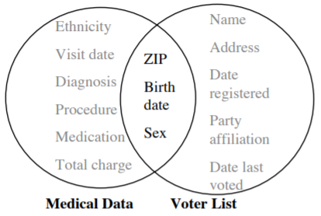
Data Asset Governance
Control
Implementation Technologies
Data protection and data sharing for storage, communication, query
Anonymization: Anonymization or de-identification is achieved by removing any information that might identify an individual within a dataset.
Ad-hoc anonymization method
Ad-hoc anonymisation might reasonably remove names, addresses, phone numbers etc and replace each user’s record(s) with a pseudonym value to act as an identifier under the assumption that individuals cannot be identified within the altered dataset.
Evaluation: In the presence of auxiliary information, linkage attacks allow an adversary to re-identify individuals in the otherwise anonymous dataset.
k-anonymity method
k-anonymity was proposed by Sweeney to tackle the challenge of linkage attacks on anonymized datasets. A release provides k-anonymity protection if the information for each person contained in the release cannot be distinguished from at least k-1 individuals whose information also appears in the release.
Evaluation: Research related to improving k-anonymity based methods has mostly been abandoned in the literature in preference of methods that offer more rigorous privacy guarantees (such as differntial privacy)
Abouelmehdi K, Beni-Hssane A, Khaloufi H, et al. Big data security and privacy in healthcare: A Review[J]. Procedia Computer Science, 2017, 113: 73-80.
Briggs C, Fan Z, Andras P. A Review of Privacy Preserving Federated Learning for Private IoT Analytics[J]. arXiv preprint arXiv:2004.11794, 2020.
Sweeney L. k-anonymity: A model for protecting privacy[J]. International Journal of Uncertainty, Fuzziness and Knowledge-Based Systems, 2002, 10(05): 557-570.
Linking to re-identify data
Notes:
The figure above provides a demonstration of re-identification by directly linking (or “matching”) on shared attributes.

Slide 15
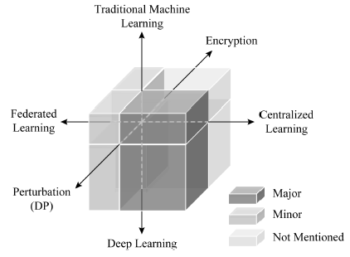
Data Asset Governance
Control
Implementation Technologies
Data protection and data sharing for statistics or modeling of machine learning
Model training mode in statistics or modeling
Centralized learning
Federated learning (distributed learning)
Privacy-preserving techniques
Encryption method including homomorphic encryption and secure multi-party computing
Perturbation method represented by differential privacy
Junxu L, Xiaofeng M. Survey on Privacy-Preserving Machine Learning[J]. Journal of Computer Research and Development, 2020, 57(2): 346.
Notes:
In the figure, existing machine learning privacy protection research is divided from the three dimensions of model training mode, privacy protection technology and model type. The color depth represents the proportion of the corresponding content in this article.
Before the advent of deep learning, traditional machine learning models based on statistical learning theory were the main methods used to solve various data mining tasks and simple learning tasks.
Protection mechanisms should protect various aspects: Input features, Output labels or responses, Model details including the architecture, parameters and loss function, Identifiable information such as which party contributed to a specific record.

Slide 16
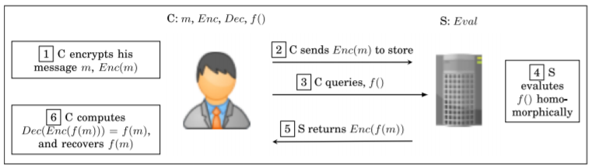
Data Asset Governance
Control
Implementation Technologies
Data protection and data sharing for statistics or modeling of machine learning
Model training mode in statistics or modeling
Privacy-preserving techniques
Encryption method
Homomorphic encryption
Homomorphic encryption (HE) allows for processing of data in its encrypted form. Earlier efforts (termed “Somewhat Homomorphic Encryption”) allowed for simple addition and multiplication operations on encrypted data, but were shortly followed by Fully Homomorphic Encryption allowing for any arbitrary function to be applied to data in ciphertext form to yield an encrypted result.
Gentry C. Computing arbitrary functions of encrypted data[J]. Communications of the ACM, 2010, 53(3): 97-105.
Acar A, Aksu H, Uluagac A S, et al. A survey on homomorphic encryption schemes: Theory and implementation[J]. ACM Computing Surveys (CSUR), 2018, 51(4): 1-35.
Du Y, Gustafson L, Huang D, et al. Implementing ML Algorithms with HE[M]//MIT Course 6. 857: Computer and Network Security. 2017.
A simple client-server HE scenario, where C is Client and S is Server.
Notes:
Encrypting data provides better privacy protection but the ability to perform useful statistical analysis on encrypted data requires specialist methods. Despite the apparent advantages of homomorphic encryption to provide privacy to individuals over their data whilst allowing a third party to perform analytics on it, the computational overhead required to perform such operations is very large. IBM’s homomorphic library implementation runs some 50 million times slower than performing calculations on plaintext data. Applying homomorphic encryption to training on large-scale machine learning data is currently impractical.
In this scenario, the client, C, first encrypts his or her private data (Step 1), then sends the encrypted data to the cloud servers, S, (Step 2). When the client wants to perform a function (i.e., query), f (), over his or her own data, he or she sends the function to the server (Step 3). The server performs a homomorphic operation over the encrypted data using the Eval function, i.e., computes f () blindfolded (Step 4) and returns the encrypted result to the client (Step 5). Finally, the client recovers the data with his or her own secret key and obtains f (m) (Step 6). As seen in this simple example, the homomorphic operation, Eval(), at the server side does not require the private key of the client and allows various operations such as addition and multiplication on the encrypted client data.

Slide 17
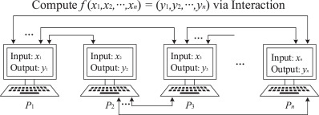
Data Asset Governance
Control
Implementation Technologies
Data protection and data sharing for statistics or modeling of machine learning
Model training mode in statistics or modeling
Privacy-preserving techniques
Encryption method
Secure multi-party computation
Secure multi-party computation (SMC) can be adopted to compute a function on private data owned by many parties such that no party learns anything about others’ data - only the output of the function. Many SMC protocols are based on Shamir’s secret sharing which splits data into n pieces in such a way that at least k pieces are required to reconstruct the original data (k −1) pieces reveal nothing about the original data). The data can only be reconstructed if the shared pieces on k servers are known.
Goldreich O. Secure multi-party computation[J]. Manuscript. Preliminary version, 1998, 78.
Launchbury J, Archer D, DuBuisson T, et al. Application-scale secure multiparty computation[C]//European Symposium on Programming Languages and Systems. Springer, Berlin, Heidelberg, 2014: 8-26.
Zhao C, Zhao S, Zhao M, et al. Secure multi-party computation: theory, practice and applications[J]. Information Sciences, 2019, 476: 357-372.
Jagannathan G, Wright R N. Privacy-preserving distributed k-means clustering over arbitrarily partitioned data[C]//Proceedings of the eleventh ACM SIGKDD international conference on Knowledge discovery in data mining.
Diagram of Secure Multi-Party Computation.
Notes:
SMC has been used for learning decision trees, linear regression functions, association rules, Naive Bayes classifiers, and k-means clustering.
SMC techniques impose non-trivial performance overheads and their application to privacy-preserving deep learning remains an open problem.
In an SMPC setting, two or more parties Pi (i=1,2,…,n) with private inputs xi in a distributed computing environment wish to jointly and interactively compute an objective functionality f(x1,x2,…,xn) =(y1,y2,…,yn) based on their private inputs. Once the computation is complete, each party Pi should obtain its own corresponding output yi without acquiring any other information (as shown in Figure).

Slide 18
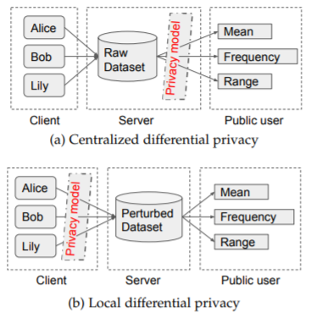
Data Asset Governance
Control
Implementation Technologies
Data protection and data sharing for statistics or modeling of machine learning
Model training mode in statistics or modeling
Privacy-preserving techniques
Perturbation method
Differential privacy
Differential privacy is an example of a perturbative privacy preserving method, as the privacy guarantee is achieved by the addition of noise to the true output. This noise is commonly drawn from a Laplacian distribution but can also be drawn from a exponential distribution or via the novel staircase mechanism.
Input perturbation: Input perturbation refers to a certain degree of random disturbance of personal data before it is handed over to the model for learning or analysis to avoid the model from acquiring real data. Input perturbations have centralized privacy and local privacy.
Dwork C. Differential privacy: A survey of results[C]//International conference on theory and applications of models of computation. Springer, Berlin, Heidelberg, 2008: 1-19.
Hassan M U, Rehmani M H, Chen J. Differential privacy techniques for cyber physical systems: a survey[J]. IEEE Communications Surveys & Tutorials, 2019, 22(1): 746-789.
Yang M, Lyu L, Zhao J, et al. Local differential privacy and its applications: A comprehensive survey[J]. arXiv preprint arXiv:2008.03686, 2020.Kasiviswanathan S P, Smith A. On the'semantics' of differential privacy: A bayesian formulation[J]. Journal of Privacy and Confidentiality, 2014, 6(1).
Chaudhuri K, Monteleoni C, Sarwate A D. Differentially private empirical risk minimization[J]. Journal of Machine Learning Research, 2011, 12(3).
Ji Z, Lipton Z C, Elkan C. Differential privacy and machine learning: a survey and review[J]. arXiv preprint arXiv:1412.7584, 2014.
Comparison of two differential privacy models
Notes:
Figure shows the comparison of the framework of centralized differential privacy and local differential privacy. For centralized differential privacy, the data curator possess the users’ true data. While under the local differential privacy model, the curator holds the perturbed data instead of the raw data, the query is performed on the perturbed dataset. Therefore, local differential privacy prevents the privacy disclosure from the untrusted data curator and relieves the burden on the trusted data curator to keep data secure.

Slide 19
Data Asset Governance
Control
Implementation Technologies
Data protection and data sharing for statistics or modeling of machine learning
Model training mode in statistics or modeling
Privacy-preserving techniques
Perturbation method
Differential privacy
Output perturbation: Output perturbation refers to directly adding noise to the optimal parameters obtained by minimizing empirical risk.
Objective perturbation: Objective perturbation refers to the introduction of random terms into the objective function expression to minimize the empirical risk, and to ensure that the solution process meets differential privacy.
Gradient perturbation: Gradient perturbation refers to the introduction of random noise in the process of using gradient descent to solve the optimal model parameters, and to ensure that the entire process meets differential privacy.
Dwork C. Differential privacy: A survey of results[C]//International conference on theory and applications of models of computation. Springer, Berlin, Heidelberg, 2008: 1-19.
Hassan M U, Rehmani M H, Chen J. Differential privacy techniques for cyber physical systems: a survey[J]. IEEE Communications Surveys & Tutorials, 2019, 22(1): 746-789.
Yang M, Lyu L, Zhao J, et al. Local differential privacy and its applications: A comprehensive survey[J]. arXiv preprint arXiv:2008.03686, 2020.Kasiviswanathan S P, Smith A. On the'semantics' of differential privacy: A bayesian formulation[J]. Journal of Privacy and Confidentiality, 2014, 6(1).
Chaudhuri K, Monteleoni C, Sarwate A D. Differentially private empirical risk minimization[J]. Journal of Machine Learning Research, 2011, 12(3).
Ji Z, Lipton Z C, Elkan C. Differential privacy and machine learning: a survey and review[J]. arXiv preprint arXiv:1412.7584, 2014.
Notes:
Accumulated knowledge is one of the weaknesses of differential privacy to keep sensitive data private. Another is collusion. If multiple users collude in the querying of the data (sharing the results of queries with one another) the budget for any single user might be breached.

Slide 20
Data Asset Governance
Control
Implementation Technologies
Data protection and data sharing for statistics or modeling of machine learning
Model training mode in statistics or modeling
Privacy-preserving techniques
Hybrid method
Anatomization and perturbation techniques
The hybrid method focuses on the goal of preserving privacy by anatomizing and perturbing the quasi identifiers in the sensitive data of customers stored on centralized data repository without causing any loss to the information.
Encryption (symmetric and asymmetric techniques) and horizontally partitioned data
This is an approach of implementing encryption on different attribute and different rows in one data set.
Lohiya S, Ragha L. Privacy preserving in data mining using hybrid approach[C]//2012 Fourth International Conference on Computational Intelligence and Communication Networks. IEEE, 2012: 743-746.
Vashi D, Bhadka H B, Patel K, et al. An Efficient Hybrid Approach of Attribute Based Encryption For Privacy Preserving Through Horizontally Partitioned Data[J]. Procedia Computer Science, 2020, 167: 2437-2444.
Hasan M M, Hossain S, Paul M K, et al. A New Hybrid Approach For Privacy Preserving Data Mining Using Matrix Decomposition Technique[C]//2019 4th International Conference on Electrical Information and Communication Technology (EICT). IEEE, 2019: 1-5.

Slide 21
Data Asset Governance
Control
Implementation Technologies
Data protection and data sharing for statistics or modeling of machine learning
Model training mode in statistics or modeling
Privacy-preserving techniques
Application and issues of Privacy-preserving techniques
New application issues of privacy-preserving techniques
Extremely large number of nodes
Train a high-quality centralized model
Training data locally on users’ mobile devices
The devices are used as compute nodes
Distributed networks of devices
Challenges of the privacy-preserving problem
Communication efficiency
Massively Distributed, Non-IID, and Unbalanced
Minimizing the number of rounds of communication
Protect individual privacy data independently
From machine learning to deep learning
Jakub Konecny, H. Brendan McMahan, Daniel Ramage, and Peter Richtárik. 2016. Federated Optimization: Distributed Machine Learning for On-Device Intelligence. CoRR abs/1610.02527 (2016).
Jakub Konecny, H. Brendan McMahan, Felix X. Yu, Peter Richtárik, Ananda Theertha Suresh, and Dave Bacon. 2016. Federated Learning: Strategies for Improving Communication Efficiency. CoRR abs/1610.05492 (2016).
McMahan H B, Moore E, Ramage D, et al. Federated learning of deep networks using model averaging[J]. 2016.

Slide 22
Data Asset Governance
Control
Implementation Technologies
Data protection and data sharing for statistics or modeling of machine learning
Model training mode in statistics or modeling
Privacy-preserving techniques
Application and issues of Privacy-preserving techniques
Federated learning
Definition of Federated Learning
A federated learning system is a learning process in which the data owners collaboratively train a model, in which process any data owner does not expose its data to others. Federated learning can be considered as privacy-preserving decentralized collaborative machine learning.
Federated Learning vs Distributed Machine Learning
Distributed machine learning covers many aspects, including distributed storage of training data, distributed operation of computing tasks, distributed distribution of model results, etc.
Compared to distributed machine learning, federated learning is faced with a more complex learning environment, and federated learning emphasizes the data privacy protection of the data owner during the model training process.
Yang Q, Liu Y, Chen T, et al. Federated machine learning: Concept and applications[J]. ACM Transactions on Intelligent Systems and Technology (TIST), 2019, 10(2): 1-19.

Slide 23
Data Asset Governance
Control
Implementation Technologies
Data protection and data sharing for statistics or modeling of machine learning
Model training mode in statistics or modeling
Privacy-preserving techniques
Application and issues of Privacy-preserving techniques
Federated learning
Definition of Federated Learning
A federated learning system is a learning process in which the data owners collaboratively train a model, in which process any data owner does not expose its data to others. Federated learning can be considered as privacy-preserving decentralized collaborative machine learning.
Federated Learning vs Distributed Machine Learning
Distributed machine learning covers many aspects, including distributed storage of training data, distributed operation of computing tasks, distributed distribution of model results, etc.
Compared to distributed machine learning, federated learning is faced with a more complex learning environment, and federated learning emphasizes the data privacy protection of the data owner during the model training process.
Yang Q, Liu Y, Chen T, et al. Federated machine learning: Concept and applications[J]. ACM Transactions on Intelligent Systems and Technology (TIST), 2019, 10(2): 1-19.
Li Q, Wen Z, Wu Z, et al. A survey on federated learning systems: vision, hype and reality for data privacy and protection[J]. arXiv preprint arXiv:1907.09693, 2019.
Vepakomma P, Swedish T, Raskar R, et al. No Peek: A Survey of private distributed deep learning[J]. arXiv preprint arXiv:1812.03288, 2018.
Kairouz P, McMahan H B, Avent B, et al. Advances and open problems in federated learning[J]. arXiv preprint arXiv:1912.04977, 2019.
Li T, Sahu A K, Talwalkar A, et al. Federated learning: Challenges, methods, and future directions[J]. IEEE Signal Processing Magazine, 2020, 37(3): 50-60.

Slide 24
Data Asset Governance
Control
Implementation Technologies
Data protection and data sharing for statistics or modeling of machine learning
Model training mode in statistics or modeling
Privacy-preserving techniques
Application and issues of Privacy-preserving techniques
Federated learning
Definition of Federated Learning
Federated Learning vs Distributed Machine Learning
Federated optimization problem
Complex learning environment: non-i.i.d. data, Unbalanced data, Massively distributed data, Limited communication, Unreliable participating clients
Communication efficiency in federated optimization: Communication efficiency is of the utmost importance and minimizing the number of rounds of communication is the principal goal
Chen Y, Sun X, Jin Y. Communication-efficient federated deep learning with asynchronous model update and temporally weighted aggregation[J]. arXiv preprint arXiv:1903.07424, 2019.
Konečný J, McMahan H B, Yu F X, et al. Federated learning: Strategies for improving communication efficiency[J]. arXiv preprint arXiv:1610.05492, 2016.
Vepakomma P, Swedish T, Raskar R, et al. No Peek: A Survey of private distributed deep learning[J]. arXiv preprint arXiv:1812.03288, 2018.
Shi S, Tang Z, Chu X, et al. Communication-Efficient Distributed Deep Learning: Survey, Evaluation, and Challenges[J]. arXiv preprint arXiv:2005.13247, 2020.
McMahan B, Moore E, Ramage D, et al. Communication-efficient learning of deep networks from decentralized data[C]//Artificial Intelligence and Statistics. PMLR, 2017: 1273-1282.
J, McMahan H B, Ramage D, et al. Federated optimization: Distributed machine learning for on-device intelligence[J]. arXiv preprint arXiv:1610.02527, 2016.

Slide 25
Data Asset Governance
Control
Implementation Technologies
Data protection and data sharing for statistics or modeling of machine learning
Model training mode in statistics or modeling
Privacy-preserving techniques
Application and issues of Privacy-preserving techniques
Federated learning
Definition of Federated Learning
Federated Learning vs Distributed Machine Learning
Federated optimization problem
Categorization of federated learning
From a data asset governance perspective
From a unique technology perspective

Slide 26
Data Asset Governance
Control
Implementation Technologies
Data protection and data sharing for statistics or modeling of machine learning
Categorization of federated learning
From a data asset governance perspective
Ownership and control federated learning
This type of approach can effectively realize the ownership and control of data assets by all parties involved in model training.
Value allocation federated learning
This type of approach can effectively measure the data contribution of all parties involved and allocate value according to the size of the contribution.
Federated learning with blockchain
This type of approach combines the advantages of the blockchain and can provide value discovery, confirmation, and circulation records for participants in model training.

Slide 27
Data Asset Governance
Control
Implementation Technologies
Data protection and data sharing for statistics or modeling of machine learning
Categorization of federated learning
From a data asset governance perspective
Ownership and control federated learning
Mobile keyboard prediction with federated learning
The federated learning environment gives users greater control over the use of their data and simplifies the task of incorporating privacy by default with distributed training and aggregation across a population of client devices.
Digital health with federated learning
In a FL setting, each data controller not only defines their own governance processes and associated privacy considerations, but also, by not allowing data to move or to be copied, controls data access and the possibility to revoke it.
Internet of Things with federated learning
Drug discovery with federated learning
Personalized federated learning
Personalized federated learning allows every client to train a strong personalized cloud model by effectively collaborating with the other clients in a privacy-preserving manner.
Hard A, Rao K, Mathews R, et al. Federated learning for mobile keyboard prediction[J]. arXiv preprint arXiv:1811.03604, 2018.
Rieke N, Hancox J, Li W, et al. The future of digital health with federated learning[J]. arXiv preprint arXiv:2003.08119, 2020.
Huang Y, Chu L, Zhou Z, et al. Personalized Federated Learning: An Attentive Collaboration Approach[J]. arXiv preprint arXiv:2007.03797, 2020.

Slide 28
Data Asset Governance
Control
Implementation Technologies
Data protection and data sharing for statistics or modeling of machine learning
Categorization of federated learning
From a data asset governance perspective
Ownership and control federated learning
Value allocation federated learning
Profit Allocation for Federated Learning
Contribution index is a new Shapley value based metric fit for assessing the contribution of each data provider for the joint model trained by federated learning.
The key idea of these methods is that we only need to records intermediate results during the training process of federated learning and use these intermediate results to calculate the CIs approximately.
The first method reconstructs models by updating the initial global model in federated learning with the gradients in different rounds. Then it calculates the contribution index by the performance of these reconstructed models. The second method calculates contribution index in each round by updating the global model in the previous round with the gradients in the current round. Contribution indexes of multiple rounds are then added with elaborated weights to get the final result.
Song T, Tong Y, Wei S. Profit Allocation for Federated Learning[C]//2019 IEEE International Conference on Big Data (Big Data). IEEE, 2019: 2577-2586.
Notes:
A measure of the contribution for each party in FML enables fair credits allocation. Fairly appraise each data source and compensate data owners for their contribution.

Slide 29
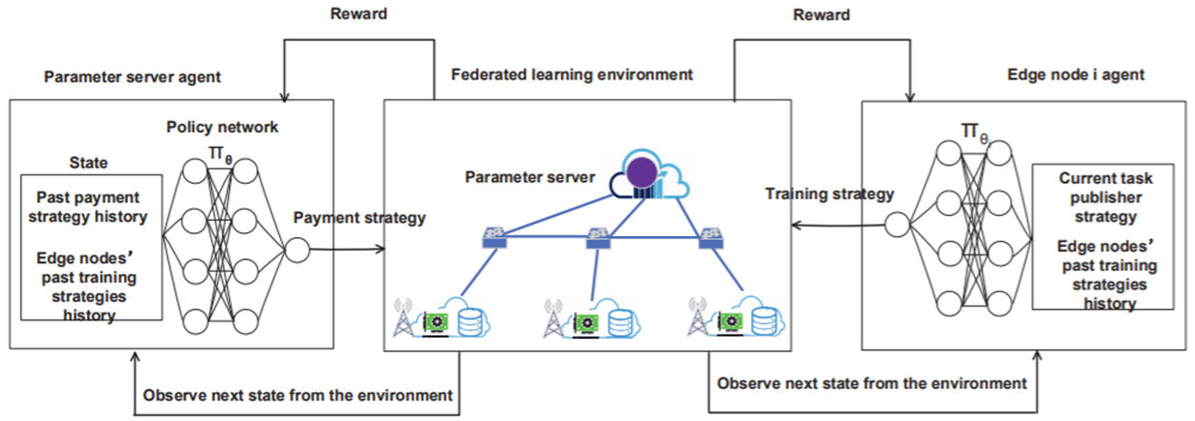
Data Asset Governance
Control
Implementation Technologies
Data protection and data sharing for statistics or modeling of machine learning
Categorization of federated learning
From a data asset governance perspective
Ownership and control federated learning
Value allocation federated learning
Profit Allocation for Federated Learning
A Learning-based Incentive Mechanism for Federated Learning
A deep reinforcement learning-based (DRL) incentive mechanism has been designed to determine the optimal pricing strategy for the parameter server and the optimal training strategies for edge nodes.
Zhan Y, Li P, Qu Z, et al. A learning-based incentive mechanism for federated learning[J]. IEEE Internet of Things Journal, 2020.
The workflow of using DRL for incentive mechanism
design in federated learning.
Notes:
A measure of the contribution for each party in FML enables fair credits allocation. Fairly appraise each data source and compensate data owners for their contribution.
In this paper, authors study the incentive mechanism for federated learning to motivate edge nodes to contribute model training. In this figure, the parameter server acts as a leader who interacts with the environment in the DRL (deep reinforcement learning) setting. At each training period t, the parameter server agent observes a state st and determines an action τt. When this action is done, edge nodes interact with each other to determine their optimal participation level strategies.

Slide 30
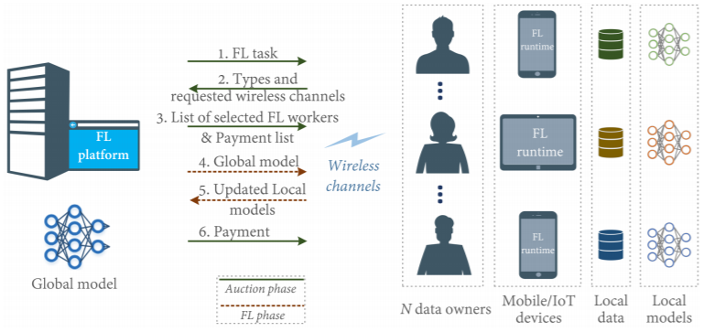
Data Asset Governance
Control
Implementation Technologies
Data protection and data sharing for statistics or modeling of machine learning
Categorization of federated learning
From a data asset governance perspective
Ownership and control federated learning
Value allocation federated learning
Profit Allocation for Federated Learning
A Learning-based Incentive Mechanism for Federated Learning
An auction based market model for incentivizing data owners
Maximize the social welfare of the federated learning services market. To improve the social welfare, authors develop an automated strategy proof mechanism based on deep reinforcement learning and graph neural networks.
Jiao Y, Wang P, Niyato D, et al. Toward an Automated Auction Framework for Wireless Federated Learning Services Market[J]. IEEE Transactions on Mobile Computing, 2020.
Federated learning services market
Notes:
A measure of the contribution for each party in FML enables fair credits allocation. Fairly appraise each data source and compensate data owners for their contribution.
Authors first design an approximate strategy-proof mechanism which guarantees the truthfulness, individual rationality, and computational efficiency. To improve the social welfare, authors develop an automated strategy-proof mechanism based on deep reinforcement learning and graph neural networks. The communication traffic congestion and the unique characteristics of federated learning are particularly considered in the proposed model.
As illustrated in Figure, the FL training process generally contains the following 3 steps, where Steps 2 and 3 form an iterative loop between the platform and the workers: Step 1 (task initialization): The platform determines the
training task, i.e., the target application, and the corresponding data requirements. Step 2 (local model training and update) Step 3 (global model aggregation and update): The platform receives and aggregates the local models from workers, and then sends the updated global model parameters back.

Slide 31
Data Asset Governance
Control
Implementation Technologies
Data protection and data sharing for statistics or modeling of machine learning
Categorization of federated learning
From a data asset governance perspective
Ownership and control federated learning
Value allocation federated learning
Profit Allocation for Federated Learning
A Learning-based Incentive Mechanism for Federated Learning
An auction based market model for incentivizing data owners
A Principled Approach to Data Valuation for Federated Learning
The Federated Shapley value preserves the desirable properties of the canonical SV while it can be calculated without incurring extra communication cost and is also able to capture the effect of participation order on data value.
Wang T, Rausch J, Zhang C, et al. A Principled Approach to Data Valuation for Federated Learning[J]. arXiv preprint arXiv:2009.06192, 2020.
Wang G, Dang C X, Zhou Z. Measure contribution of participants in federated learning[C]//2019 IEEE International Conference on Big Data (Big Data). IEEE, 2019: 2597-2604.
Notes:
A measure of the contribution for each party in FML enables fair credits allocation. Fairly appraise each data source and compensate data owners for their contribution.
The Shapley value (SV) defines a unique payoff scheme that satisfies many desiderata for a data value notion. It has been increasingly used for valuing training data in centralized learning. However, computing the SV requires exhaustively evaluating the model performance on every subset of data sources, which incurs prohibitive communication cost in the federated setting. Besides, the canonical SV ignores the order of data sources during training, which conflicts with the sequential nature of FL. This paper proposes a variant of the SV amenable to FL, which we call the federated Shapley value.

Slide 32
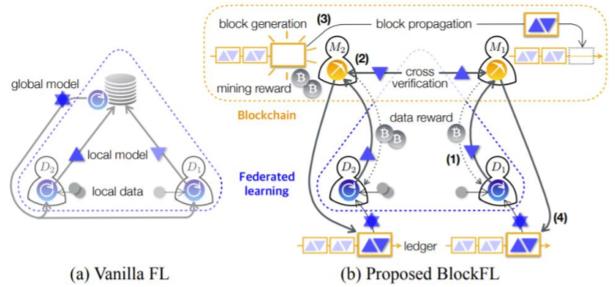
Data Asset Governance
Control
Implementation Technologies
Data protection and data sharing for statistics or modeling of machine learning
Categorization of federated learning
From a data asset governance perspective
Ownership and control federated learning
Value allocation federated learning
Federated Learning with Blockchain
Record and Reward Federated Learning Contributions with Blockchain
An EOS Blockchain to establish data security, a novel validation error based metric upon which we qualify gradient uploads for payment, and implement a small example of our blockchain Federated Learning model to analyze its performance.
Martinez I, Francis S, Hafid A S. Record and Reward Federated Learning Contributions with Blockchain[C]//2019 International Conference on Cyber-Enabled Distributed Computing and Knowledge Discovery (CyberC). IEEE, 2019: 50-57.
As described in the proposal for BlockFL, the architecture of
BlockFL compared to ”Vanilla” Federated Learning
Notes:
Block chain is embedded in federated learning to further improve its application effect in data asset governance.
BlockFL uses blockchain to reward users for their local updates proportional to how many local data points are used as shown in Figure. The payment to devices is left to the miner to pay ”out-of-pocket”, which is not a lasting solution if miners pay devices more than they are rewarded for blocks. This device reward benefits an honest node; however, this value may be inflated by a malicious node seeking higher reward.
As described in the proposal for BlockFL, the architecture of BlockFL compared to ”Vanilla” Federated Learning.

Slide 33
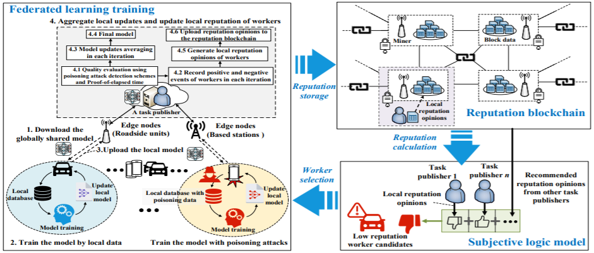
Data Asset Governance
Control
Implementation Technologies
Data protection and data sharing for statistics or modeling of machine learning
Categorization of federated learning
From a data asset governance perspective
Ownership and control federated learning
Value allocation federated learning
Federated Learning with Blockchain
Record and Reward Federated Learning Contributions with Blockchain
Reliable Federated Learning for Mobile Networks with Blockchain
Consortium blockchain is leveraged as a decentralized approach for achieving efficient reputation management of the workers without repudiation and tampering. By numerical analysis, the proposed approach is demonstrated to improve the reliability of federated learning tasks in mobile networks.
Kang J, Xiong Z, Niyato D, et al. Reliable federated learning for mobile networks[J]. IEEE Wireless Communications, 2020, 27(2): 72-80.
Consortium blockchain-based reputation management
for secure federated learning
Notes:
Block chain is embedded in federated learning to further improve its application effect in data asset governance.
In the federated learning, training data is widely distributed and maintained on the mobile devices as workers. A central aggregator updates a global model by collecting local updates from mobile devices using their local training data to train the global model in each iteration. However, unreliable data may be uploaded by the mobile devices (i.e., workers), leading to frauds in tasks of federated learning. The workers may perform unreliable updates intentionally, e.g., the data poisoning attack, or unintentionally, e.g., low-quality data caused by energy constraints or high-speed mobility. Therefore, finding out trusted and reliable workers in federated learning tasks becomes critical.
As shown in Figure, the mobile devices collect local sensing data and generate various user data from mobile applications. Mobile applications with federated learning perform model training by using these data without the need of data aggregation for privacy preservation. The detailed steps about the federated learning are shown as follows: Step 1: Task publishment, Step 2: Worker selection, Step 3: Reputation calculation, Step 4: Federated learning,
Step 5: Reputation updating.

Slide 34
Data Asset Governance
Control
Implementation Technologies
Data protection and data sharing for statistics or modeling of machine learning
Categorization of federated learning
From a data asset governance perspective
Ownership and control federated learning
Value allocation federated learning
Federated Learning with Blockchain
Record and Reward Federated Learning Contributions with Blockchain
Reliable Federated Learning for Mobile Networks with Blockchain
Identify and exclude Byzantine members in federated learning systems via blockchain
A proof-of-concept for managing security issues in federated learning systems via blockchain technology. It uses decentralized programs executed via blockchain technology to establish secure learning coordination mechanisms and to identify and exclude Byzantine members.
Bernabe J B, Canovas J L, Hernandez-Ramos J L, et al. Privacy-preserving solutions for Blockchain: review and challenges[J]. IEEE Access, 2019, 7: 164908-164940.
El Rifai O, Biotteau M, de Boissezon X, et al. Blockchain-Based Federated Learning in Medicine[C]//International Conference on Artificial Intelligence in Medicine. Springer, Cham, 2020: 214-224.
Zhu X, Li H, Yu Y. Blockchain-based privacy preserving deep learning[C]//International Conference on Information Security and Cryptology. Springer, Cham, 2018: 370-383.
Notes:
Block chain is embedded in federated learning to further improve its application effect in data asset governance.
To this end, the notion of federated learning (FL) was proposed, which leaves the training data distributed on the mobile devices, and learns a shared model by aggregating locally-computed updates. However, in many applications one or more Byzantine devices may suffice to let current coordination learning mechanisms fail with unpredictable or disastrous outcomes.
This approach provides a proof-of-concept for managing security issues in federated learning systems via blockchain technology, and uses decentralized programs executed via blockchain technology to establish secure learning coordination mechanisms and to identify and exclude Byzantine members.

Slide 35
Data Asset Governance
Control
Implementation Technologies
Data protection and data sharing for statistics or modeling of machine learning
Categorization of federated learning
From a data asset governance perspective
From a unique technology perspective
Communication-efficient federated learning
Privacy-preserving Federated Learning
Secure-hardware federated learning
An interesting hardware-based approach is to use trusted execution environment (TEE) which can guarantee that code and data loaded inside are protected. Such environment can be used inside the central server to increase its credibility. The Trusted Execution Environment (TEE), such as SGX, is a set of instructions by which applications can create protected memory regions for the execution of programs. These regions can be seen as enclaves isolated from any other code in the system, such as operating system and hypervisor. The processor only allows code running in an enclave to access data in the enclave.
Shi S, Tang Z, Chu X, et al. Communication-Efficient Distributed Deep Learning: Survey, Evaluation, and Challenges[J]. arXiv preprint arXiv:2005.13247, 2020.
Shokri R, Shmatikov V. Privacy-preserving deep learning[C]//Proceedings of the 22nd ACM SIGSAC conference on computer and communications security. 2015: 1310-1321.
Sattler F, Wiedemann S, Müller K R, et al. Robust and communication-efficient federated learning from non-iid data[J]. IEEE transactions on neural networks and learning systems, 2019.
Zhang C, Li S, Xia J, et al. Batchcrypt: Efficient homomorphic encryption for cross-silo federated learning[C]//2020 {USENIX} Annual Technical Conference ({USENIX}{ATC} 20). 2020: 493-506.
Chen Y, Luo F, Li T, et al. A training-integrity privacy-preserving federated learning scheme with trusted execution environment[J]. Information Sciences, 2020, 522: 69-79.

Slide 36
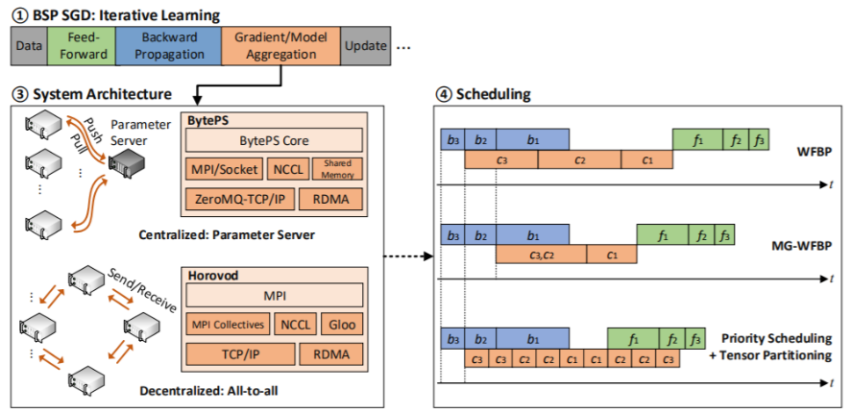
Data Asset Governance
Control
Implementation Technologies
Data protection and data sharing for statistics or modeling of machine learning
Categorization of federated learning
From a data asset governance perspective
From a unique technology perspective
Communication-efficient federated learning
Communication Optimizations in Distributed Deep Learning
Optimization Algorithm: Communication Synchronization, Communication Compression, Scheduling
System Architecture: Centralized architecture--Parameter server (PS), Decentralized architecture--all-to-all (A2A), PS and A2A represent two different design philosophies, with different communication properties.
Communication Infrastructure: At the bottom level, there are diverse communication infrastructures offering the fundamental data communication services, which include communication protocols and network topologies. The optimization techniques in this level are also lossless.
Shi S, Tang Z, Chu X, et al. Communication-Efficient Distributed Deep Learning: Survey, Evaluation, and Challenges[J]. arXiv preprint arXiv:2005.13247, 2020.
A communication optimization portfolio in distributed DL.
Notes:
Figure gives an illustration of the communication optimization techniques in system architecture design and scheduling algorithms.
These techniques are lossless, making them particularly appealing to industry practitioners because model accuracy is the most important for many AI applications

Slide 37
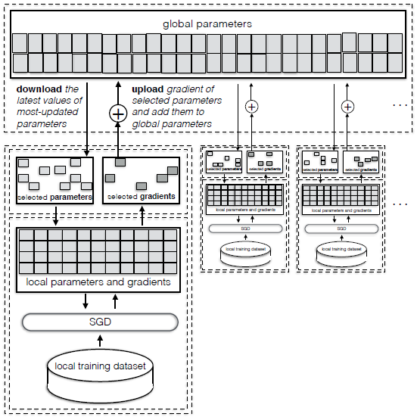
Data Asset Governance
Control
Implementation Technologies
Data protection and data sharing for statistics or modeling of machine learning
Categorization of federated learning
From a data asset governance perspective
From a unique technology perspective
Communication-efficient federated learning
Communication Optimizations in Distributed Deep Learning
Distributed Selective SGD for a distributed, collaborative deep learning protocol
A practical system for collaborative deep learning that offers an attractive tradeoff between utility and privacy.
Shokri R, Shmatikov V. Privacy-preserving deep learning[C]//Proceedings of the 22nd ACM SIGSAC conference on computer and communications security. 2015: 1310-1321.
High-level architecture of the Privacy-Preserving Deep Learning system.
Notes:
Figure illustrates the main components and protocols of the collaborative deep learning system. Assume that there are N participants, each of which has a local private dataset available for training. All participants agree in advance on a common network architecture and common learning objective. Assume the existence of a parameter server which is responsible for maintaining the latest values of parameters available to all parties. This parameter server is an abstraction, which can be implemented by an actual server or emulated by a distributed system.

Slide 38
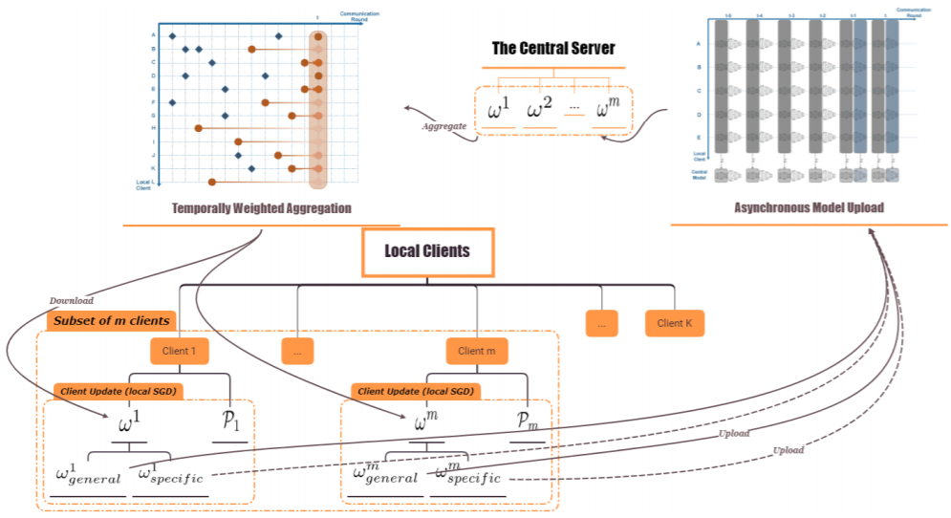
Data Asset Governance
Control
Implementation Technologies
Data protection and data sharing for statistics or modeling of machine learning
Categorization of federated learning
From a data asset governance perspective
From a unique technology perspective
Communication-efficient federated learning
Communication Optimizations in Distributed Deep Learning
Distributed Selective SGD for a distributed, collaborative deep learning protocol
Asynchronous Model Update and Temporally Weighted Aggregation
A synchronous learning strategy on the clients and a temporally weighted aggregation of the local models on the server.
Chen Y, Sun X, Jin Y. Communication-efficient federated deep learning with asynchronous model update and
temporally weighted aggregation[J]. arXiv preprint arXiv:1903.07424, 2019.
Federated learning with asynchronous model update
and temporally weighted aggregation
Notes:
In the asynchronous learning strategy, different layers of the deep neural networks are categorized into shallow and deeps layers and the parameters of the deep layers are updated less frequently than those of the shallow layers. Furthermore, a temporally weighted aggregation strategy is introduced on the server to make use of the previously trained local models, thereby enhancing the accuracy and convergence of the central model.
The framework of the proposed federated learning with an asynchronous model update and temporally weighted aggregation is illustrated in Figure.

Slide 39
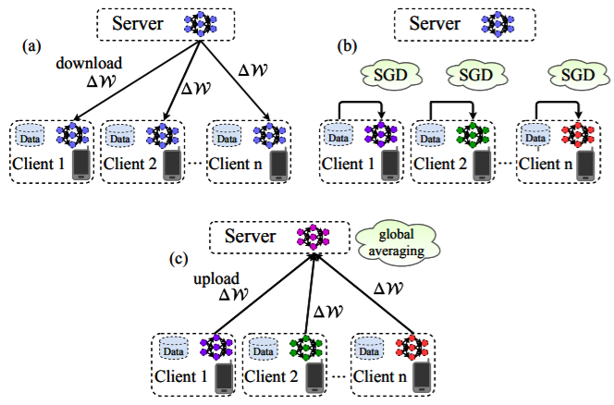
Data Asset Governance
Control
Implementation Technologies
Data protection and data sharing for statistics or modeling of machine learning
Categorization of federated learning
From a data asset governance perspective
From a unique technology perspective
Communication-efficient federated learning
Communication Optimizations in Distributed Deep Learning
Distributed Selective SGD for a distributed, collaborative deep learning protocol
Asynchronous Model Update and Temporally Weighted Aggregation
Robust and Communication-Efficient Federated Learning from Non-IID Data
Sparse Ternary Compression (STC), a new compression framework that is specifically designed to meet the requirements of the Federated Learning environment. STC extends the existing compression technique of top-k gradient sparsification with a novel mechanism to enable downstream compression as well as ternarization and optimal Golomb encoding of the weight updates.
Sattler F, Wiedemann S, Müller K R, et al. Robust and communication-efficient federated learning from non-iid data[J]. IEEE transactions on neural networks and learning systems, 2019.
Federated Learning with a parameter server
Notes:
Figure Illustrated is one communication round of distributed SGD:
(a) Clients synchronize with the server.
(b) Clients compute a weight update independently based on their local data.
(c) Clients upload their local weight updates to the server,
where they are averaged to produce the new master model.

Slide 40
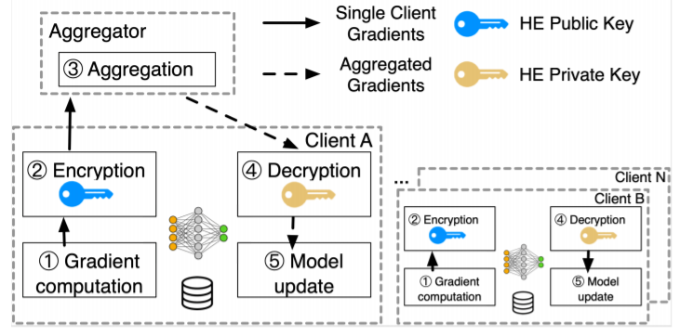
Data Asset Governance
Control
Implementation Technologies
Data protection and data sharing for statistics or modeling of machine learning
Categorization of federated learning
From a data asset governance perspective
From a unique technology perspective
Communication-efficient federated learning
Privacy-preserving Federated Learning
Federated Learning with Homomorphic encryption
A system solution for cross-silo FL that substantially reduces the encryption and communication overhead caused by HE.
Zhang C, Li S, Xia J, et al. Batchcrypt: Efficient homomorphic encryption for cross-silo federated learning[C]//2020 {USENIX} Annual Technical Conference ({USENIX}{ATC} 20). 2020: 493-506.
The architecture of cross-silo FL system, where HE is
implemented as a pluggable module on the clients.
Notes:
Cross-silo federated learning (FL) enables organizations (e.g., financial or medical) to collaboratively train a machine learning model by aggregating local gradient updates from each client without sharing privacy-sensitive data. To ensure no update is revealed during aggregation, industrial FL frameworks allow clients to mask local gradient updates using additively homomorphic encryption (HE).
Figure depicts a typical cross-silo FL system, where HE is implemented as a pluggable module on the clients. The aggregator is the server which coordinates the clients and aggregates their encrypted gradients.

Slide 41
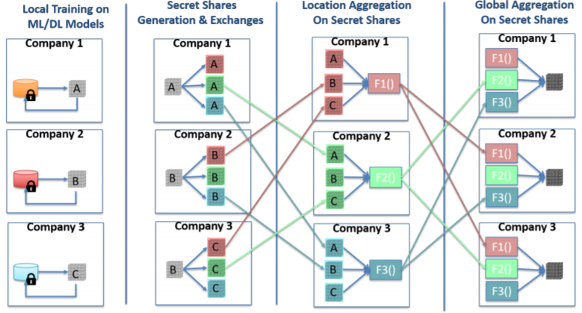
Data Asset Governance
Control
Implementation Technologies
Data protection and data sharing for statistics or modeling of machine learning
Categorization of federated learning
From a data asset governance perspective
From a unique technology perspective
Communication-efficient federated learning
Privacy-preserving Federated Learning
Federated Learning with Homomorphic encryption
Federated Learning with Secure multi-party computation (SMC)
Adopt Multi-Party Computation (MPC) to achieve privacy-preserving model aggregation for FL. The MPC-enabled model aggregation in a peer-to-peer manner incurs high communication overhead with low scalability.
Kanagavelu R, Li Z, Samsudin J, et al. Two-Phase Multi-Party Computation Enabled Privacy-Preserving Federated Learning[J]. arXiv preprint arXiv:2005.11901, 2020.
MPC-enabled Privacy-Preserving Model Aggregation
Notes:
A two-phase mechanism by 1) electing a small committee and 2) providing MPC-enabled model aggregation service to a larger number of participants through the committee.

Slide 42
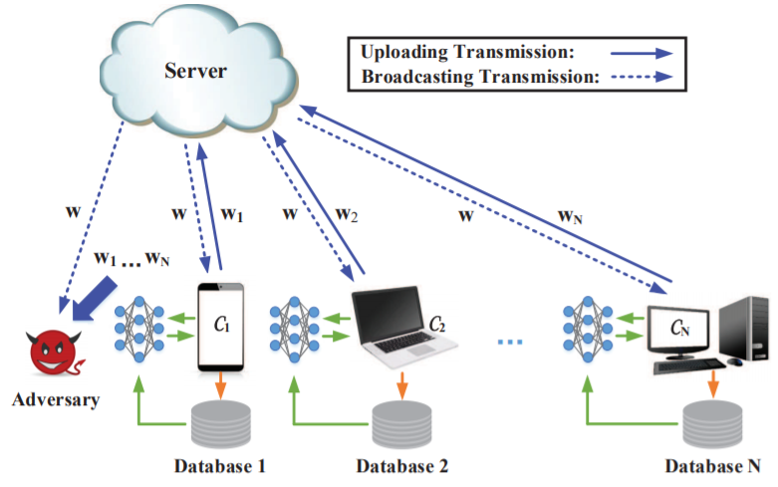
Data Asset Governance
Control
Implementation Technologies
Data protection and data sharing for statistics or modeling of machine learning
Categorization of federated learning
From a data asset governance perspective
From a unique technology perspective
Communication-efficient federated learning
Privacy-preserving Federated Learning
Federated Learning with Homomorphic encryption
Federated Learning with Secure multi-party computation (SMC)
Federated Learning with Differential privacy
A novel framework based on the concept of differential privacy (DP), in which artificial noises are added to the parameters at the clients side before aggregating, namely, noising before model aggregation FL (NbAFL).
Wei K, Li J, Ding M, et al. Federated Learning with Differential Privacy: Algorithms and Performance Analysis[J]. arXiv, 2019: arXiv: 1911.00222.
A FL training model with hidden adversaries who can eavesdrop trained parameters from both the clients and the server.
Notes:
Authors develop a theoretical convergence bound of the loss function of the trained FL model in the NbAFL.
Specifically, the theoretical bound reveals the following three key properties: 1) There is a tradeoff between a convergence performance and privacy protection levels, i.e., better convergence performance leads to a lower protection level; 2) Given a fixed privacy protection level, increasing the number N of overall clients participating in FL can improve the convergence performance; and 3) There is an optimal number aggregation times (communication rounds) in terms of convergence performance for a given protection level.
Figure shows a general FL system consisting of one server and N clients. The training process of such a FL system usually contains the following four steps: Step 1: Local training, Step 2: Model aggregating, Step 3: Parameters broadcasting, Step 4: Model updating.

Slide 43
Data Asset Governance
Control
Implementation Technologies
Data protection and data sharing for statistics or modeling of machine learning
Categorization of federated learning
From a data asset governance perspective
From a unique technology perspective
Communication-efficient federated learning
Privacy-preserving Federated Learning
Federated Learning with Homomorphic encryption
Federated Learning with Secure multi-party computation (SMC)
Federated Learning with Differential privacy
Federated Learning with Hybrid approach
Existing federated learning approaches either use secure multiparty computation (SMC) which is vulnerable to inference or differential privacy which can lead to low accuracy given a large number of parties with relatively small amounts of data each.
An alternative approach that utilizes both differential privacy and SMC to balance these trade-offs.
Truex S, Baracaldo N, Anwar A, et al. A hybrid approach to privacy-preserving federated learning[C]//Proceedings of the 12th ACM Workshop on Artificial Intelligence and Security. 2019: 1-11.

Slide 44
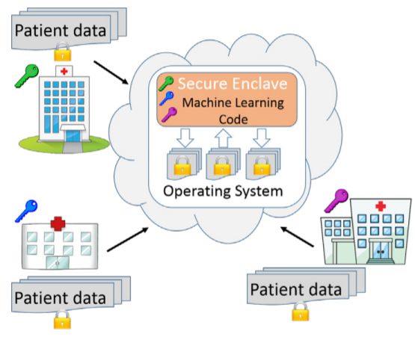
Data Asset Governance
Control
Implementation Technologies
Data protection and data sharing for statistics or modeling of machine learning
Categorization of federated learning
From a data asset governance perspective
From a unique technology perspective
Communication-efficient federated learning
Privacy-preserving Federated Learning
Secure-hardware federated learning
Oblivious Multi-Party Machine Learning on Trusted Processors
Data-oblivious machine learning algorithms for support vector machines, matrix factorization, neural networks, decision trees, and k-means clustering.
Ohrimenko O, Schuster F, Fournet C, et al. Oblivious multi-party machine learning on trusted processors[C]//25th {USENIX} Security Symposium ({USENIX} Security 16). 2016: 619-636.
Sample privacy-preserving multi-party machine learning system.
Notes:
An interesting hardware-based approach is to use trusted execution environment (TEE) which can guarantee that code and data loaded inside are protected. Such environment can be used inside the central server to increase its credibility.
Figure shows a sample privacy-preserving multi-party machine learning system. Multiple hospitals encrypt patient datasets, each with a different key. The hospitals deploy an agreed-upon machine learning algorithm in an enclave in a cloud data center and share their data keys with the enclave. The enclave processes the aggregate datasets and outputs an encrypted machine learning model.

Slide 45
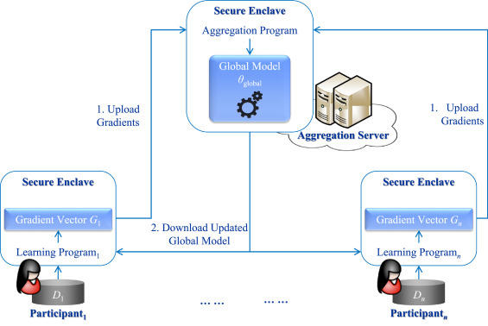
Data Asset Governance
Control
Implementation Technologies
Data protection and data sharing for statistics or modeling of machine learning
Categorization of federated learning
From a data asset governance perspective
From a unique technology perspective
Communication-efficient federated learning
Privacy-preserving Federated Learning
Secure-hardware federated learning
Oblivious Multi-Party Machine Learning on Trusted Processors
A training-integrity protocol based on the Trusted Execution Environment (TEE)
A new privacy-preserving federated learning scheme that guarantees the integrity of deep learning processes, in which causative attacks can be detected. Traditional causative attacks corrupt the training data to change the model’s behaviour at inference time.
Chen Y, Luo F, Li T, et al. A training-integrity privacy-preserving federated learning scheme with trusted execution environment[J]. Information Sciences, 2020, 522: 69-79.
System architecture
Notes:
An interesting hardware-based approach is to use trusted execution environment (TEE) which can guarantee that code and data loaded inside are protected. Such environment can be used inside the central server to increase its credibility.
Figure illustrates the main parties of our learning system, including some participants and an aggregations server. Participant. Authors set there are n participants. Each participant holds a local private dataset for local training. All participants reached a consensus on a global neural network architecture and a common learning goal in advance. Aggregation Server. Authors also envision the existence of a server which is responsible for aggregating the latest values of model parameters available to all parties. Normally, such an aggregation server is an abstraction that can be implemented by an actual cloud server.

Slide 46
Data Asset Governance
Control
Implementation Technologies
Data protection and data sharing for statistics or modeling of machine learning
Model training mode in statistics or modeling
Privacy-preserving techniques
Application and issues of Privacy-preserving techniques
Federated learning
Definition of Federated Learning
Federated Learning vs Distributed Machine Learning
Federated optimization problem
Categorization of federated learning
Applications of Federated learning
Applications framework
Applications cases
Secure and privacy-preserving AI

Slide 47
Data Asset Governance
Control
Implementation Technologies
Data protection and data sharing for statistics or modeling of machine learning
Applications of Federated learning
Applications framework
Federated learning for government
Key elements of Federated Learning
Data , Learning model, Federated aggregation operators, Clients and federated server, Communication among the federated server and the clients
Federated Government
Data distribution, Federated aggregator, Model
Frameworks analysis
FL and DP features comparison among existing frameworks
PySyft, TensorFlow, FATE, LEAF, PaddleFL
Bonawitz K, Eichner H, Grieskamp W, et al. Towards federated learning at scale: System design[J]. arXiv preprint arXiv:1902.01046, 2019.
Rodríguez-Barroso N, Stipcich G, Jiménez-López D, et al. Federated Learning and Differential Privacy: Software tools analysis, the Sherpa. ai FL framework and methodological guidelines for preserving data privacy[J]. Information Fusion, 2020, 64: 270-292.
Ma C, Li J, Ding M, et al. On Safeguarding Privacy and Security in the Framework of Federated Learning[J]. IEEE Network, 2020.
Federated Government
Data distribution
Federated
aggregator
Model
Private mechanism
Data (IID or Non-IID scenario)
Federated Averaging, CO-OP
Notes:
The prospective matching of federated learning and differential privacy to the challenges of data privacy protection has caused the release of several software tools that support their functionalities, but they lack a unified vision of these techniques, and a methodological workflow that supports their usage.
Federated Averaging (FedAvg). It is based on keeping a shared global model that is periodically updated by averaging models that have been trained locally on clients. The training process is arranged by a central server which hosts the shared global model. However, the actual optimisation is done locally on clients.
CO-OP. It proposes an asynchronous approach, which merges any received client model with the global model. Instead of directly averaging the models, the merging between a local model and the global model is carried out using a weighting scheme based on a measure of the difference in the age of the models. This is motivated by the fact that in an asynchronous framework, some clients will be trained on obsolete data while others will be trained on more up-to-date data.

Slide 48
Data Asset Governance
Control
Implementation Technologies
Data protection and data sharing for statistics or modeling of machine learning
Applications of Federated learning
Applications framework
Federated learning for government
The technology architecture and modeling processes of federated learning
Aledhari M, Razzak R, Parizi R M, et al. Federated learning: A survey on enabling technologies, protocols, and applications[J]. IEEE Access, 2020, 8: 140699-140725.
Mothukuri V, Parizi R M, Pouriyeh S, et al. A survey on security and privacy of federated learning[J]. Future Generation Computer Systems, 2020.
Notes:
Data partitioning
Machine learning model
Privacy mechanism

Slide 49
Data Asset Governance
Control
Implementation Technologies
Data protection and data sharing for statistics or modeling of machine learning
Applications of Federated learning
Applications framework
Federated learning for government
The technology architecture and modeling processes of federated learning
Federated learning frameworks for different data partitioning scenarios
Yang Q, Liu Y, Chen T, et al. Federated machine learning: Concept and applications[J]. ACM Transactions on Intelligent Systems and Technology (TIST), 2019, 10(2): 1-19.
Aledhari M, Razzak R, Parizi R M, et al. Federated learning: A survey on enabling technologies, protocols, and applications[J]. IEEE Access, 2020, 8: 140699-140725.
Mothukuri V, Parizi R M, Pouriyeh S, et al. A survey on security and privacy of federated learning[J]. Future Generation Computer Systems, 2020.
Notes:
Data partitioning
Machine learning model
Privacy mechanism

Slide 50
Data Asset Governance
Control
Implementation Technologies
Data protection and data sharing for statistics or modeling of machine learning
Applications of Federated learning
Applications framework
Applications cases
Internet of Things (IoT) field case
Driverless cars, Industrial IoT
Mobile edge networks, Mobile keyboard
Healthcare field case
Medical/Hospital, Personal health
Financial field case
Bank, Users’ credit, identifying fraudulent credit card transactions
Marketing field case
User’s purchase desire
Education field case
The degree of the students
Deist T M, Dankers F J W M, Ojha P, et al. Distributed learning on 20 000+ lung cancer patients–The Personal Health Train[J]. Radiotherapy and Oncology, 2020, 144: 189-200.
Silva S, Gutman B A, Romero E, et al. Federated learning in distributed medical databases: Meta-analysis of large-scale subcortical brain data[C]//2019 IEEE 16th international symposium on biomedical imaging (ISBI 2019). IEEE, 2019: 270-274.
Kaissis G A, Makowski M R, Rückert D, et al. Secure, privacy-preserving and federated machine learning in medical imaging[J]. Nature Machine Intelligence, 2020: 1-7.
Notes:
Data partitioning
Machine learning model
Privacy mechanism

Slide 51
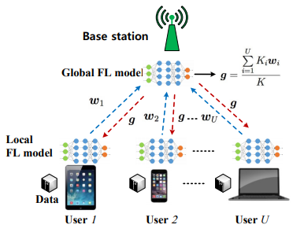
Data Asset Governance
Control
Implementation Technologies
Data protection and data sharing for statistics or modeling of machine learning
Applications of Federated learning
Applications framework
Applications cases
Internet of Things (IoT) field case
The wireless environment
The wireless environment is distributed across the network and the base station (BS) cannot collect all of this scattered data to implement a centralized learning algorithm
Limited wireless bandwidth
Key elements of optimization problem
joint learning
wireless resource allocation
user selection problem
Solution
A closed-form expression for the expected convergence rate of the FL algorithm is first derived to quantify the impact of wireless factors on FL
Based on the expected convergence rate of the FL algorithm, the optimal transmit power for each user is derived, under a given user selection and uplink resource block (RB) allocation scheme.
The user selection and uplink RB allocation is optimized so as to minimize the FL loss function
The architecture of an FL algorithm that is being executed over a wireless network with multiple devices and a single base station.
Chen M, Yang Z, Saad W, et al. A joint learning and communications framework for federated learning over wireless networks[J]. arXiv preprint arXiv:1909.07972, 2019.
Notes:
As shown in Figure, the uplink from the users to the BS is used to transmit the local FL model parameters while the downlink is used to transmit the global FL model parameters.

Slide 52
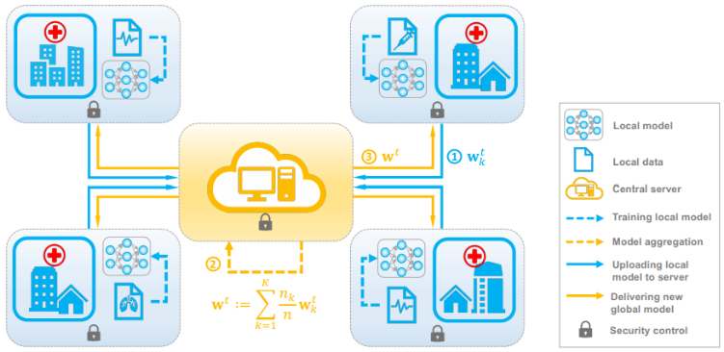
Data Asset Governance
Control
Implementation Technologies
Data protection and data sharing for statistics or modeling of machine learning
Applications of Federated learning
Applications framework
Applications cases
Internet of Things (IoT) field case
Healthcare field case
The Healthcare environment case
Key elements of optimization problem
Model compression, clients selection, updates reducing, peer-to-peer learning
Solution
Statistical Challenges of Federated Learning: Consensus Solution, Pluralistic Solution
Communication Efficiency of Federated Learning
Privacy and Security
some probably encountered directions or open questions
Data Quality, Incorporating Expert Knowledge, Incentive Mechanisms, Personalization, Model Precision
Schematic of the federated learning framework
Xu J, Wang F. Federated learning for healthcare informatics[J]. arXiv preprint arXiv:1911.06270, 2019.
Notes:
Different hospitals own the electronic health records (EHR) of different patient populations and these records are difficult to share across hospitals because of their sensitive nature.
In the figure, the model is trained in a distributed manner: The institutions periodically communicate the local updates with a central server to learn a global model. The central server aggregates the updates and sends back the parameters of the updated global model.

Slide 53
Data Asset Governance
Control
Implementation Technologies
Data protection and data sharing for statistics or modeling of machine learning
Applications of Federated learning
Applications framework
Applications cases
Internet of Things (IoT) field case
Healthcare field case
The Healthcare environment case
The finance environment case
The finance environment
Key elements of optimization problem
Eliminating weight leakage, Eliminating weighted average leakage, Secure Weighted Average Protocol
Solution
The server chooses some users to produce an updated model. Those users train a model on their individual data, then send the model updates to the server. The server aggregates the updates to construct a new global model and shares it with all users.
Byrd D, Polychroniadou A. Differentially Private Secure Multi-Party Computation for Federated Learning in Financial Applications[J]. arXiv preprint arXiv:2010.05867, 2020.
Notes:
Modern financial firms routinely need to conduct analysis of large data sets stored across multiple servers or devices. The institution may not have appropriate authority or permission to transfer locally stored information, the owner of the data may not want it shared.

Slide 54
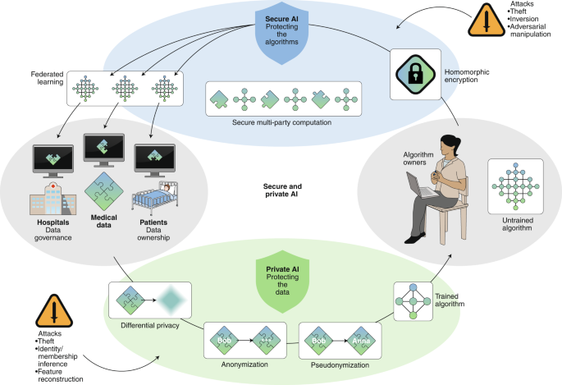
Data Asset Governance
Control
Implementation Technologies
Data protection and data sharing for statistics or modeling of machine learning
Applications of Federated learning
Applications framework
Applications cases
Secure and privacy-preserving AI
Components of the relationships and interactions
Between data, algorithms, actors and techniques in the field of secure and private AI
Schematic overview of the relationships and interactions between data, algorithms, actors and techniques in the field of secure and private AI.
Kaissis G A, Makowski M R, Rückert D, et al. Secure, privacy-preserving and federated machine learning in medical imaging[J]. Nature Machine Intelligence, 2020: 1-7.
Notes:
The term secure AI is used for methods concerned with safeguarding algorithms, and the term privacy-preserving AI for systems allowing data processing without revealing the data itself. Their combination aims to guarantee sovereignty over the input data and the algorithms, integrity of the computational process and its results, and to offer trustworthy and transparently auditable technical implementations (structured transparency).

Slide 55
Tutorial Outline
Data Asset: What and Why
Data Asset Governance
Value
Right
Type of Right: Ownership, Access, Use, Benefit
Right Confirmation (DLT)
Right Enforcement (Cryptography, DLT)
Control
Data Asset Ecosystem
Case Study: Personal Data as Emerging Asset Class
Case Study: B-to-B Data Sharing and Exchange
Challenges and Future Directions

Slide 56
Tutorial Outline
Data Asset: What and Why
Data Asset Governance
Value
Right
Control
Data Asset Ecosystem
Challenges and Future Directions

